Slide 1

SCSA1502-COMPUTER NETWORKS AND DESIGN
UNIT I
FUNDAMENTALS OF NETWORK DESIGN

Slide 2
COURSE OBJECTIVE’S
To recognize the principles of the big picture of computer networks.
To understand the networking environment.
To know the importance of VPNs.
To convey the availability of tools and techniques for networking.
To discuss about evolving technologies in networks.

Slide 3
COURSE OUTCOME
CO1 - Understand the principles of networks.
CO2 - Interpret LAN concepts and design.
CO3 - Gain knowledge in evolving technologies.
CO4 - Clearly outline the logic behind VPNs.
CO5 - Know the importance of tools and techniques in building a network.
CO6 - Understand the underlying working concepts of a real-time network.

Slide 4
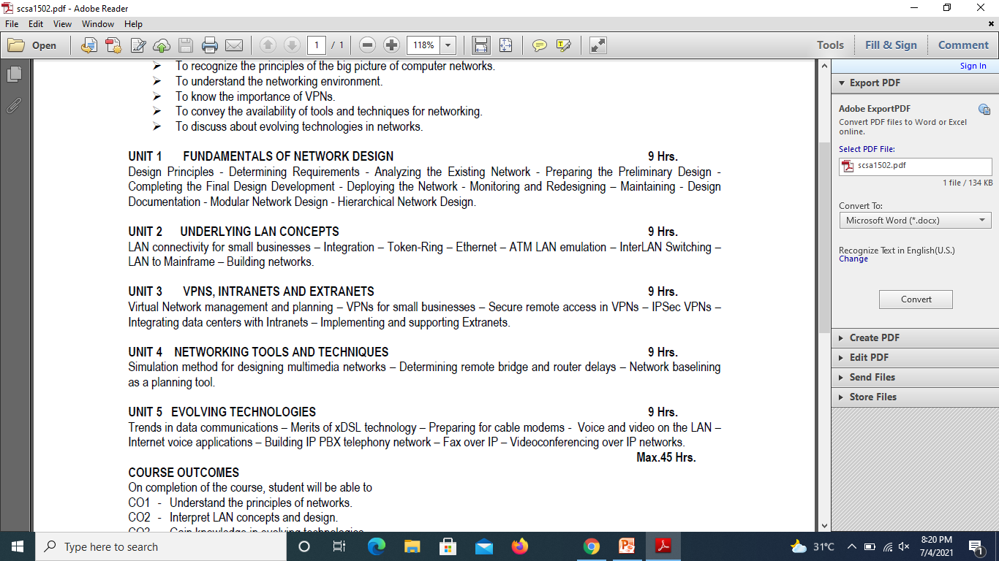
SCSA1502- COMPUTER NETWORKS & DESIGN
SYLLABUS

Slide 5
SCSA1502- COMPUTER NETWORKS & DESIGN
TEXT/ REFERENCE BOOKS
1. Gil Held, “Network Design: Principles and Applications (Best Practices)”, Auerbach Publications, 1st edition, 2000.
2. Diane Tiare and Catherine Paquet, “Campus Network Design Fundamentals”, Pearson Education, 1st edition, 2006.
3. Larry L. Peterson, Bruce S. Davie, “Computer Networks: A Systems Approach”, Morgan Kaufmann Publishers Inc., 5th edition, 2012.
4. William Stallings, “Data and Computer Communications”, Pearson Education, 8th edition, 2016.
5. James F. Kurose, Keith W. Ross, “Computer Networking - A Top-Down Approach Featuring the Internet”, Pearson Education, 6th edition, 2012.

Slide 6
UNIT 1
FUNDAMENTALS OF NETWORK DESIGN
Design Principles - Determining Requirements - Analyzing the Existing Network - Preparing the Preliminary Design -
Completing the Final Design Development - Deploying the Network - Monitoring and Redesigning – Maintaining - Design Documentation - Modular Network Design - Hierarchical Network Design.

Slide 7
NETWORK DESIGN CONCEPTS
What is the design methodology used by network designers?
Network designers ensure that our communications networks can adjust and scale to the demands for new services.
To support our network-based economy, designers must work to create networks that are available nearly 100 percent of the time.
Information network security must be designed to automatically fend off unexpected security incidents.
Using hierarchical network design principles and an organized design methodology, designers create networks that are both manageable and supportable

Slide 8
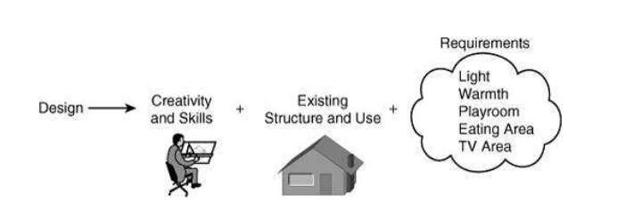
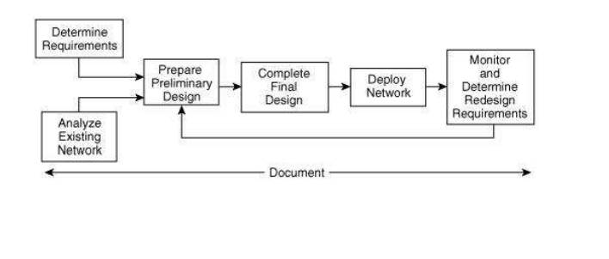
NETWORK DESIGN CONCEPTS
General Design Aspect
Network Design – Ongoing Process

Slide 9
NETWORK DESIGN BASICS
Basics of network design :
■ Network design overview
■ The benefits of a hierarchical network design
■ Network design methodology
Network Design Overview
Computers and information networks are critical to the success of businesses, both large and small. They connect people, support applications and services, and provide access to the resources that keep the businesses running. To meet the daily requirements of businesses, networks themselves are becoming quite complex.

Slide 10
NETWORK REQUIREMENTS
Today, the Internet-based economy often demands around-the-clock customer service. This means that business networks must be available nearly 100 percent of the time.
They must be smart enough to automatically protect against unexpected security incidents.
These business networks must also be able to adjust to changing traffic loads to maintain consistent application response times.
It is no longer practical to construct networks by connecting many standalone components without careful planning and design.

Slide 11
NETWORK REQUIREMENTS
Technical Requirements:
Applications that are to run on the network
Internet connections required
Addressing restrictions, for example, the use of private Internet Protocol (IP) version 4 (IPv4) addresses
Support for IP version 6 (IPv6) addresses
Other protocols that are to run on the network (for example, routing protocols)
Cabling requirements
Redundancy requirements
Use of proprietary equipment and protocols

Slide 12
NETWORK REQUIREMENTS
Technical Requirements: - continued
Existing equipment that must be supported
Network services required, including quality of service (QoS) and wireless
How security is to be integrated into the network
Network solutions required (for example, voice traffic, content networking, and storage networking)
Network management
Support for existing applications while new ones are being phased in
Bandwidth availability .

Slide 13
NETWORK REQUIREMENTS
Requirements Related to Business Issues
Budget- Capital (for new equipment) and operating (for ongoing expenses).
Schedule - This could include the phasing out of older applications, hiring of new personnel, and so forth.
People - Considerations include who will install and operate the network, what skills they have, whether they require training, whether any of these tasks will be outsourced, and so forth.
Legal Issues include any restrictions on the use and storage of data collected
History Factors include examining the existing network's structure and determining whether any person or group will block changes or additions.
Policies Consider whether current organizational policies might restrict the network design.

Slide 14
BUILDING A GOOD NETWORK
. Good networks do not happen by accident. They are the result of hard work by network designers and technicians, who identify network requirements and select the best solutions to meet the needs of a business.
The steps required to design a good network are as follows:
Step 1. Verify the business goals and technical requirements.
Step 2. Determine the features and functions required to meet the needs identified in Step 1.
Step 3. Perform a network-readiness assessment.
Step 4. Create a solution and site acceptance test plan.
Step 5. Create a project plan.

Slide 15
BUILDING A GOOD NETWORK (contd)
After the network requirements have been identified, the steps to designing a good network are followed as the project implementation moves forward.
Network users generally do not think in terms of the complexity of the underlying network. They think of the network as a way to access the applications they need, when they need them.

Slide 16
NETWORK REQUIREMENTS
. Most businesses actually have only a few requirements for their network:
■ The network should stay up all the time, even in the event of failed links, equipment failure, and overloaded conditions.
■ The network should reliably deliver applications and provide reasonable response times from any host to any host.
■ The network should be secure. It should protect the data that is transmitted over it and data stored on the devices that connect to it.
■ The network should be easy to modify to adapt to network growth and general business changes.
■ Because failures occasionally occur, troubleshooting should be easy. Finding and fixing a problem should not be too time-consuming.

Slide 17
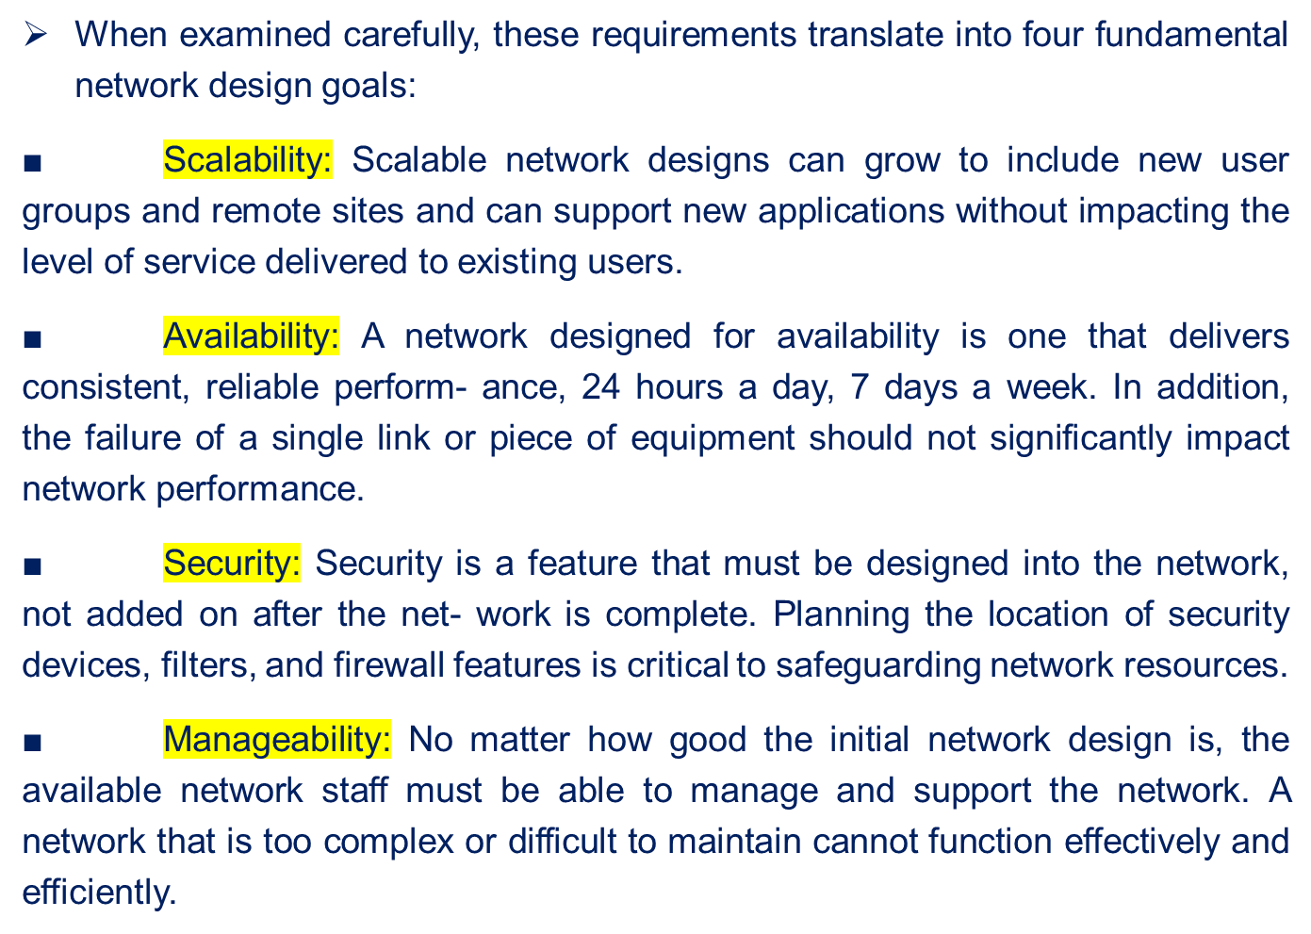
FUNDAMENTAL DESIGN GOALS

Slide 18
DESIGN PRINCIPLES
(CISCO)

Slide 19
DESIGN PRINCIPLES
A network engineer should understand the requirements for the network, as well as knowing the existing network is structured and used, is the key understanding how the new or updated network should functions and which features should be included.
Ex: CISCO has developed the Plan Design-Implement-Operate-Optimize (PDIOO) network
Plan Phase: The detailed network requirements are identified, and the existing network is reviewed.
Design Phase: The Network is designed according to the initial requirements and additional data gathered during analysis of the existing network. The design is refined with the client.

Slide 20
DESIGN PRINCIPLES (CISCO)
Implement Phase: The Network is built according to the approved design.
Operate Phase: The network is operational and is being monitored. This phase is the ultimate phase of design.
Optimize Phase: The issues are detected and corrected, Before or after the problem arises or failure has occurred. Redesign may be considered is too many problems arises.
Retirement Phase: This phase is necessary when part of the network is outdated or is no longer required.

Slide 21
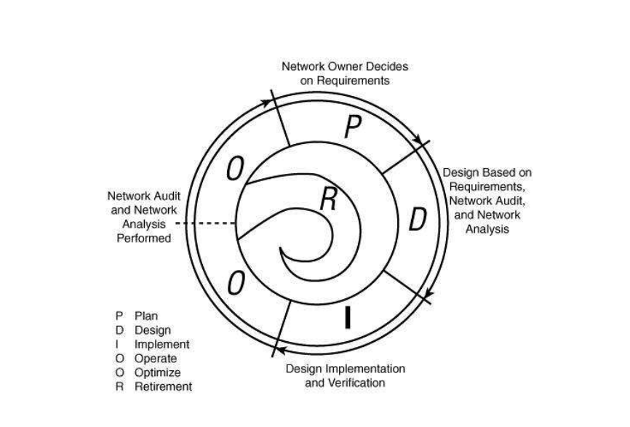
DESIGN PRINCIPLES (CISCO)
It defines the all necessary phases of a Network’s Life style
PDIOO Life Cycle Diagram

Slide 22
Benefit’s of PDIOO Cycle(CISCO)
The major Benefit’s of following PDIOO Cycle are:
Lowering the total cost of network ownership
Increasing network availability
Improving business agility
Speeding access to applications and services
PDIOO also Keeps the design process optimized and Organized

Slide 23
Benefit’s of PDIOO Cycle(CISCO)
A proper network lifecycle helps in lowering costs thereby providing a better economy for the organization by these actions:
Identifying and validating technology requirements
Planning for infrastructure changes and resource requirements
Developing a sound network design aligned with technical requirements and business goals
Accelerating successful implementation
Improving the efficiency of your network and of the staff supporting it
Reducing operating expenses by improving the efficiency of operational processes and tools

Slide 24
Benefit’s of PDIOO Cycle(CISCO)
Network availability has always been a top priority of enterprises. However, network downtime can result in a loss of revenue
The network lifecycle PDIOO improves the high availability of networks by these actions:
Assessing the network's security state and its capability to support the proposed design
Specifying the correct set of hardware and software releases, and keeping them operational and current
Producing a sound operations design and validating network operations
Staging and testing the proposed system before deployment
Improving staff skills
Proactively monitoring the system and assessing availability trends and alerts
Proactively identifying security breaches and defining remediation plans

Slide 25
Benefit’s of PDIOO Cycle(CISCO)
Business Agility (Quick Reaction to changes in Business Economy) can be increased by:
Establishing business requirements and technology strategies
Readying sites to support the system that you want to implement
Integrating technical requirements and business goals into a detailed design and demonstrating that the network is functioning as specified
Expertly installing, configuring, and integrating system components
Continually enhancing performance

Slide 26
NETWORK DESIGN
Network design should include the following task (According to CISCO)
Determine the requirements
Analyze the existing network if one exists
Prepare the preliminary design
Deploy the network
monitor and redesign if necessary
Maintain documentation (as the part of all task)

Slide 27
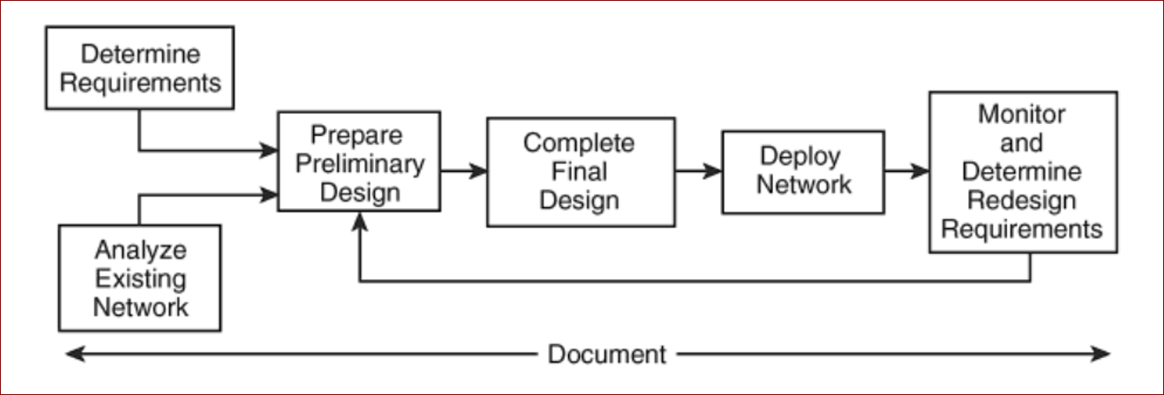
NETWORK DESIGN (CISCO

Slide 28
NETWORK DESIGN
Implementation Components
Implementation of a network design consists of several phases (install hardware, configure systems, launch into production, and so on).
Each phase consists of several steps, and each step should contain, but be not limited to, the following documentation:
Description of the step
Reference to design documents
Detailed implementation guidelines
Detailed roll-back guidelines in case of failure
Estimated time needed for implementation

Slide 29
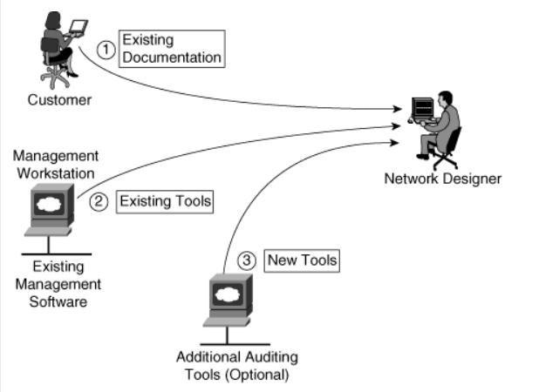
NETWORK DESIGN
Analysing the Existing Network
Existing Network system auditing sources

Slide 30
NETWORK DESIGN
Analysing the Existing Network
The second step of the design methodology is characterizing the existing network and sites
The following sections present insights into the process of examining an existing network and sites and describe the tools used to gather the data, assess the network, and analyze the network.
Customer input: Review existing documentation about the network, and use verbal input from the customer to obtain a first impression about the network
Network audit: Perform a network audit, also called an assessment, which reveals details of the network and augments the customer’s description
Traffic analysis: If possible, use traffic analysis to provide information about the applications and protocols used and to reveal any shortcomings in the network.

Slide 31
NETWORK DESIGN
Analysing the Existing Network
Customer input: includes all pertinent network and site documentation. Some items the designer could request, depending on the scope of the project, include the following:
Site contact information (especially needed if remote deployments are planned)
Existing network infrastructure (from physical diagrams and documents, and site surveys as needed), including the following:
Locations and types of servers, Locations and types of network devices
Cabling that is currently in place
Environmental controls, including heating, ventilation, and air conditioning requirements, and filtration
Locations of power receptacles etc

Slide 32
NETWORK DESIGN
Analysing the Existing Network
Customer input:- continued
Existing network infrastructure from logical topology diagrams, routing protocols in use, and the infrastructure services supported, such as voice, storage, and wireless services
Network topology: Includes devices, physical and logical links, external connections, bandwidth of connections, frame types (data link encapsulations), IP addressing, routing protocols, and so forth.
Network services: Includes security, QoS, high availability, voice, storage, wireless, and so forth.
Network applications: Examples include unified messaging and video delivery

Slide 33
Analysing the Existing Network
Auditing or Assessing the Existing Network
The Second important step is network audit or assessment
It is used to collect information about an existing network
An audit provides details such as :
A list of network devices
Hardware specifications and versions, and software versions of network devices
Configurations of network devices
Output of various auditing tools to verify and augment the existing documentation
Link, CPU, and memory utilization of network devices
A list of unused ports, modules, and slots in network devices, (to be used to understand whether the network is expandable )

Slide 34
NETWORK DESIGN
Preparing the Preliminary Design
Preliminary design involves considering all the network requirements and constraints (including the budget), and determining viable alternative solutions.
The network owner consulted, and together an optimal solution is chosen
This solution is later developed into the final design
Both the preliminary design and final design are done Using PDIOO

Slide 35
NETWORK DESIGN
Preparing the Preliminary Design
Following a design methodology can have many advantages:
It ensures that no step is missed when the process is followed
It provides a framework for the design process deliverables
It encourages consistency in the creative process, enabling network designers to set appropriate deadlines and maintain customer and manager satisfaction.
It allows customers and managers to validate that the designers have thought about how to meet their requirements
Preliminary Design Step involves in the preparation of detailed Documentation of the network
It is achieved by collecting information from customer, inspecting the site , and accessing the network using Automated Tools

Slide 36
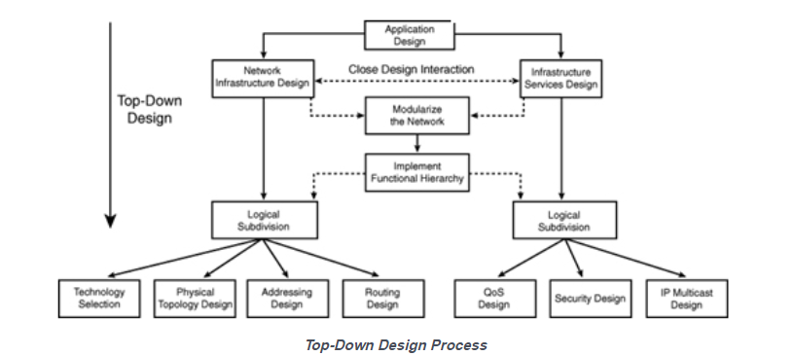
NETWORK DESIGN
Preparing the Preliminary Design
Different Approaches:
Top Down Approach:
A top-down approach to network design means that requirements are considered first, with the applications and network solutions that will run on the network driving the design

Slide 37
NETWORK DESIGN
Preparing the Preliminary Design
Different Approaches:
Bottom- Up Approach:
A bottom-up approach would first select devices, features, cabling, and so on, and then try to fit the applications onto this network
Issues in Bottom-Up Approach
A bottom-up approach can lead to redesign if the applications are not accommodated properly.
This approach can also result in increased costs by including features or devices that are not required

Slide 38
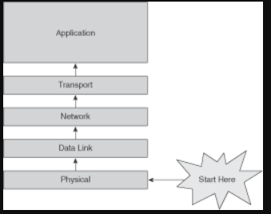
NETWORK DESIGN
Preparing the Preliminary Design
Different Approaches:
Bottom- Up Approach:
A bottom-up approach would first select devices, features, cabling, and so on, and then try to fit the applications onto this network
Issues in Bottom-Up Approach
A bottom-up approach can lead to redesign if the applications are not accommodated properly.
This approach can also result in increased costs by including features or devices that are not required

Slide 39
NETWORK DESIGN
Completing the Final Design Development
During the final design stage the detailed architectural and engineering drawings (the blueprints) of all physical components of the Network components are produced.
In some complex projects, it is necessary to prepare in addition a written final design report.
Sufficient detail must be provided by the drawings and the report should have reasonably accurate estimates involved in the process.
All revisions to materials, equipment specifications are made. The updated schedule, cost estimates and specifications should be available in the final design report.
It is essential to verify at the final design stage that the plan remains economically feasible. If, by some chance it is not, then a decision must be made to revise design solutions or the original concepts, or perhaps terminate the project

Slide 40
Network Design
Deploying the Network
Deployment of the network must start with a plan and a schedule.
Deployment planning starts in the PDIOO Design phase and continues into the Implement phase
It contains – What to be done? / How to be Done?
Contingency plans, that is, plans for what happens if a problem occurs during the implementation, should also be included
Any training required for personnel should be planned during this time
Any contracts required should be negotiated during this time. Examples include outsourcing, Internet connectivity, maintenance etc.
If all the above said points are in place the we can proceed with the implementation of the network

Slide 41
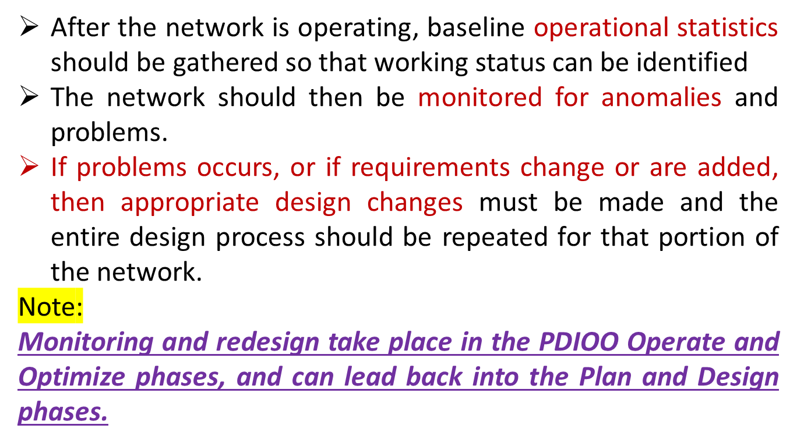
Network Design
Monitoring and Redesigning Phase:

Slide 42
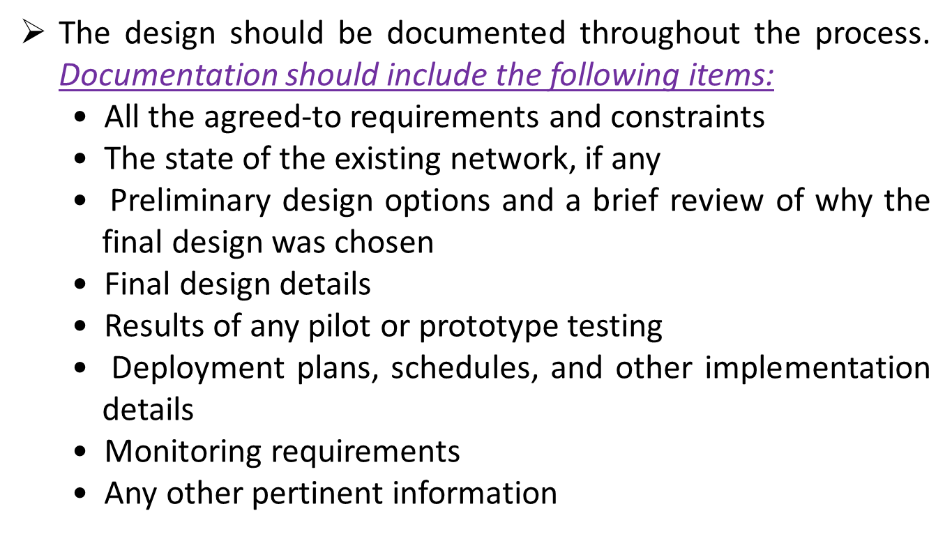
Network Design
Maintaining Design Documentation :

Slide 43
Modular Network Design
.
A module is a component of a composite structure
Modular network design involves creating modules that can then be put together to meet the requirements of the entire network.
A modular design for a network has many benefits, such as:
It is easier to understand and design smaller, simpler modules rather than an entire network
It is easier to troubleshoot smaller elements compared to the entire network
The reuse of blocks saves design time and effort, as well as implementation time and effort
The reuse of blocks allows the network to grow more easily, providing network scalability
It is easier to change modules rather than the entire network, providing flexibility of design.

Slide 44
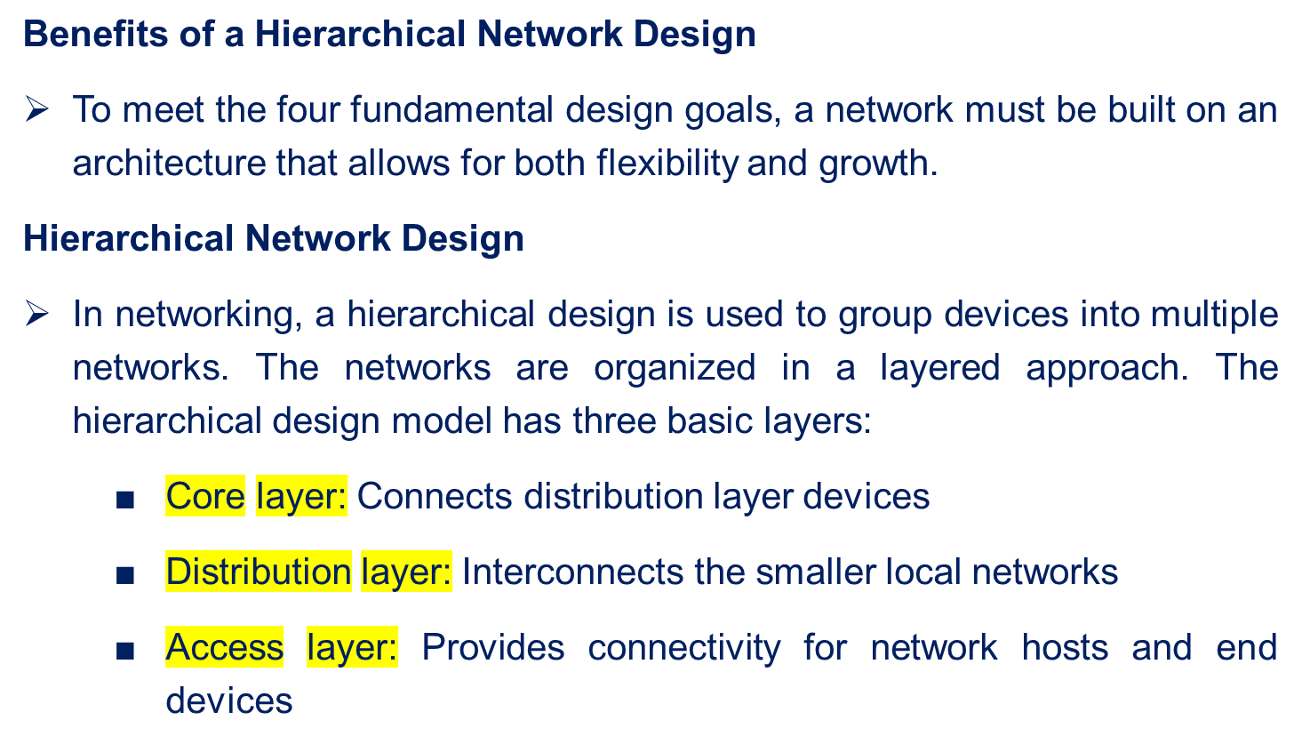
HIERARCHICAL NETWORK DESIGN

Slide 45
HIERARCHICAL NETWORK DESIGN (contd)
Hierarchical networks have advantages over flat network designs. The benefit of dividing a flat network into smaller, more manageable hierarchical blocks is that local traffic remains local.
Only traffic destined for other networks is moved to a higher layer.
Layer 2 devices in a flat network provide little opportunity to control broadcasts or to filter undesirable traffic.
As more devices and applications are added to a flat network, response times degrade until the network becomes unusable.
The following figures show the advantages of a hierarchical network design versus a flat network design.

Slide 46
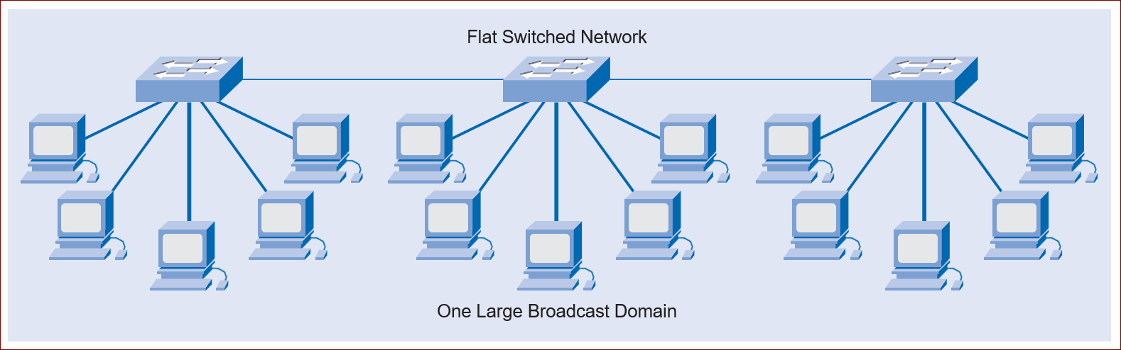
HIERARCHICAL NETWORK DESIGN (contd)
Figures Flat Network shows the advantages of a hierarchical network design versus a flat network design.
Flat Network

Slide 47
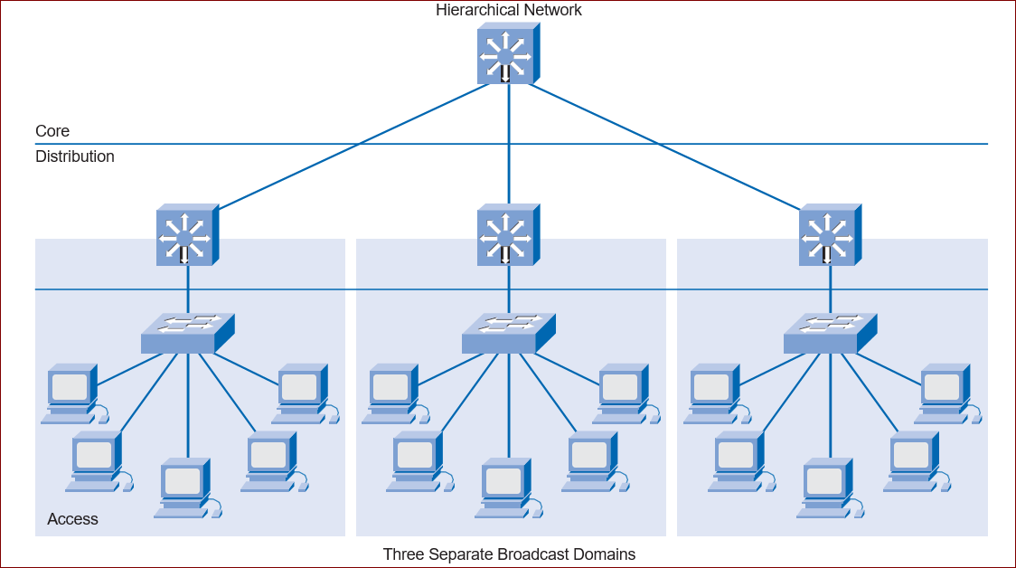
HIERARCHICAL NETWORK DESIGN (contd)
Figures Hierarchical Networkshows the advantages of a hierarchical network design versus a flat network design.
Hierarchical Network

Slide 48
NETWORK DESIGN METHODOLOGIES
Large network design projects are normally divided into three distinct steps: Step 1. Identify the network requirements.
    Step 2. Characterize the existing network.
    Step 3. Design the network topology and solutions.
Step 1: Identifying Network Requirements
The network designer works closely with the customer to document the goals of the project. Following figure depicts a meeting between the designer and the business owner. Goals are usually separated into two categories:
■ Business goals: Focus on how the network can make the business more successful
■ Technical requirements: Focus on how the technology is implemented within the network

Slide 49
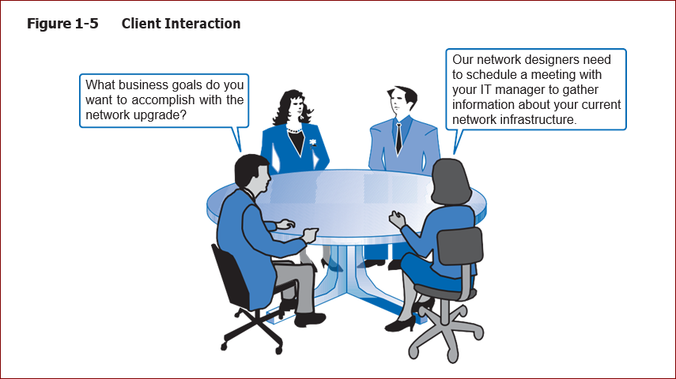
NETWORK DESIGN METHODOLOGIES)
■
A common mistake made by network designers is the failure to correctly determine the scope of the network design project

Slide 50
Step 2: Characterizing the Existing Network
Information about the current network and services is gathered and analyzed. It is necessary to compare the functionality of the existing network with the defined goals of the new project. The designer determines whether any existing equipment, infrastructure, and protocols can be reused, and what new equipment and protocols are needed to complete the design.
Step 3: Designing the Network Topology
A common strategy for network design is to take a top-down approach. In this approach, the network applications and service requirements are identified, and then the network is designed to support them.
When the design is complete, a prototype or proof-of-concept test is performed. This approach ensures that the new design functions as expected before it is implemented.

Slide 51
Determining the Scope of the Project
While gathering requirements, the designer identifies the issues that affect the entire network and those that affect only specific portions.
By creating a topology similar to following Figure the designer can isolate areas of concern and identify the scope of the project.
Failure to understand the impact of a particular requirement often causes a project scope to expand beyond the original estimate.
This oversight can greatly increase the cost and time required to implement the new design.

Slide 52
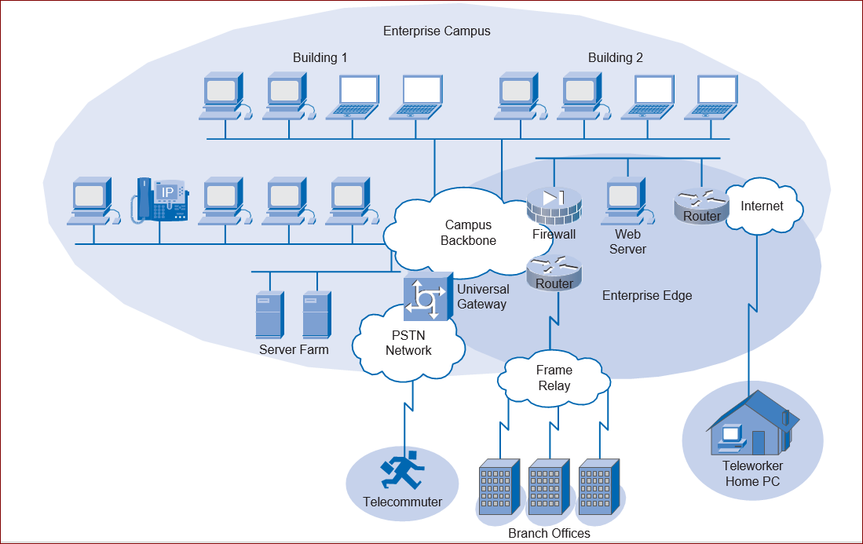
Determining the Scope of the Project

Slide 53
IMPACTING THE ENTIRE NETWORK
Network requirements that impact the entire network include the following:
■ Adding new network applications and making major changes to existing applications, such as database or Domain Name System (DNS) structure changes
■ Improving the efficiency of network addressing or routing protocol changes
■ Integrating new security measures
■ Adding new network services, such as voice traffic, content networking, and storage networking
■ Relocating servers to a data center server farm

Slide 54
IMPACTING A PORTION OF THE NETWORK
Requirements that may only affect a portion of the network include the following:
■ Improving Internet connectivity and adding bandwidth
■ Updating access layer LAN cabling
■ Providing redundancy for key services
■ Supporting wireless access in defined areas
■ Upgrading WAN bandwidth

Slide 55
THANK YOU

